Slide 1
Visualizing and Clustering Climate Change Milestone 3
Lei Zhong
Hantian Zhang
Jian Zhang

Slide 2
Data Model

Slide 3
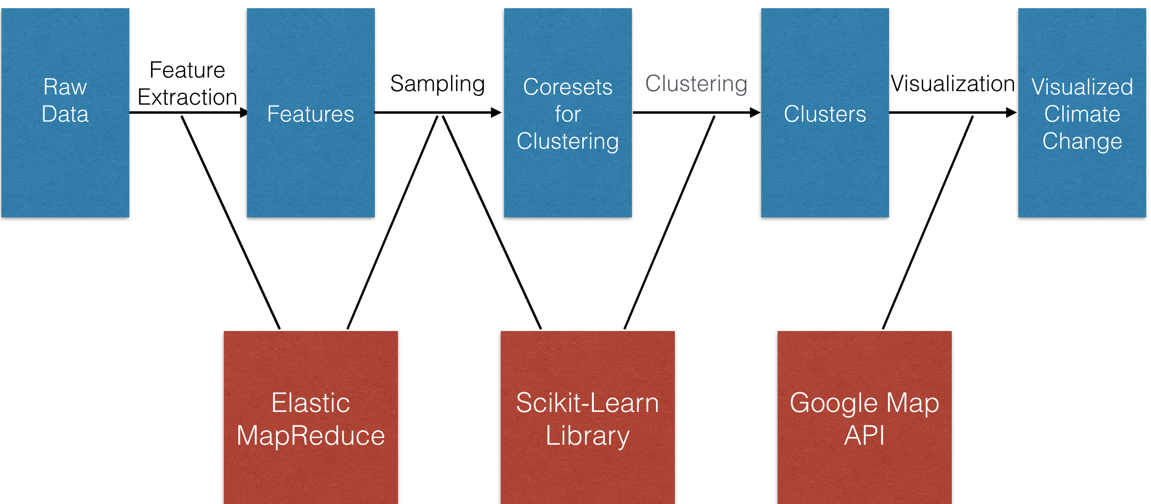
System Atchitecture

Slide 4
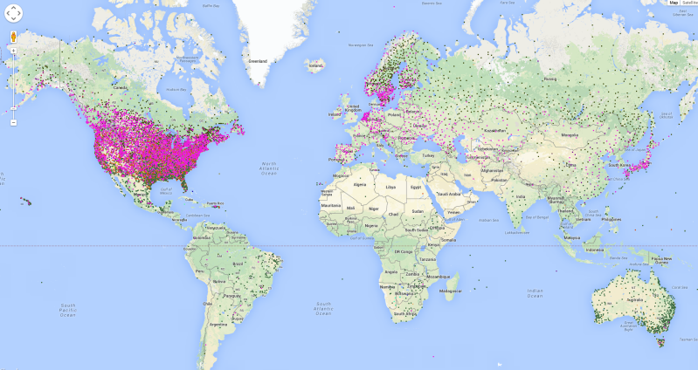
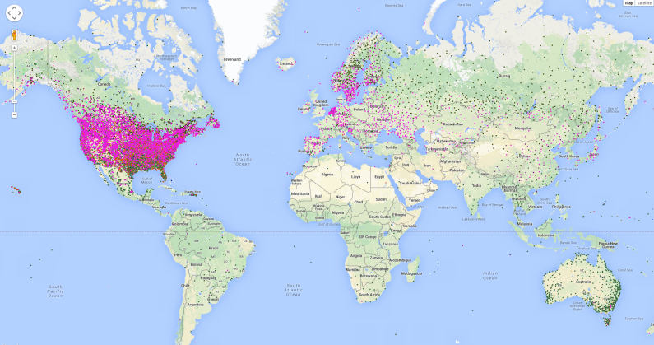
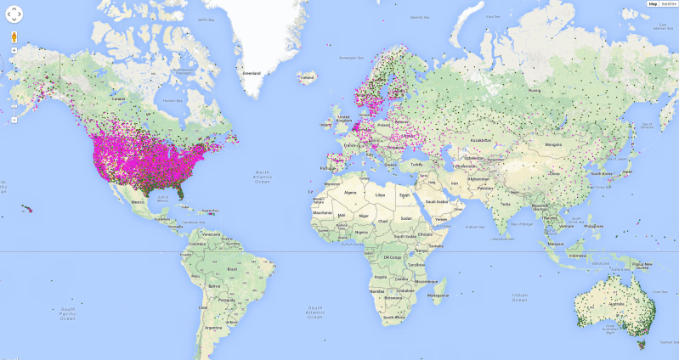
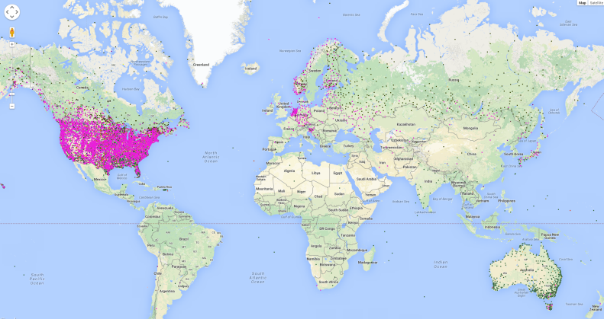
Analysis on Results
1983
1993
2003
2013
Analysis on Results
Only 3 big clusters
Lack of preserved points in areas other than the US
3. Big clusters covering the same areas

Slide 5
Analysis on Results (Cont.)
2003
2013
Possible Solutions
Only 3 big clusters
Investige distribution of weights for coreset points
Possibly update our sampling strategy
Lack of preserved points in areas other than the US
Adjust threshold of number of missing features for invalid data elimination

Slide 6
Thanks!

